Slide 1
Sentiment Analyzer
Avinash Rampersad – CS664

Slide 2
Context
The goal of this project was to create a program that would be able to take the input of a user as natural language (paragraph in this case) about anything and be able to determine if the context behind it is negative or positive to a degree of certainty.
This particular project will take in a paragraph about someone’s day and then be able to decide if they had a good day or bad day or take in a paragraph about how someone feels and be able to tell if they are in a good mood or bad mood.
Note* This can be tested with anything from a review on amazon for a product.

Slide 3
Requirements Met
Natural Language
The program will take in Natural Language and then process it based on its prior training for typical associations between positive and negative words. The program can then analyze input based on these uncertainties.
Uncertainty
The program has a few steps. The first is the training step. Where you use about 25000 inputs that negative positive or negative connotations and train the computer to figure out which are good and bad based on learned probability.
It can then tell you your mood or how your day was to a degree of certainty.

Slide 4
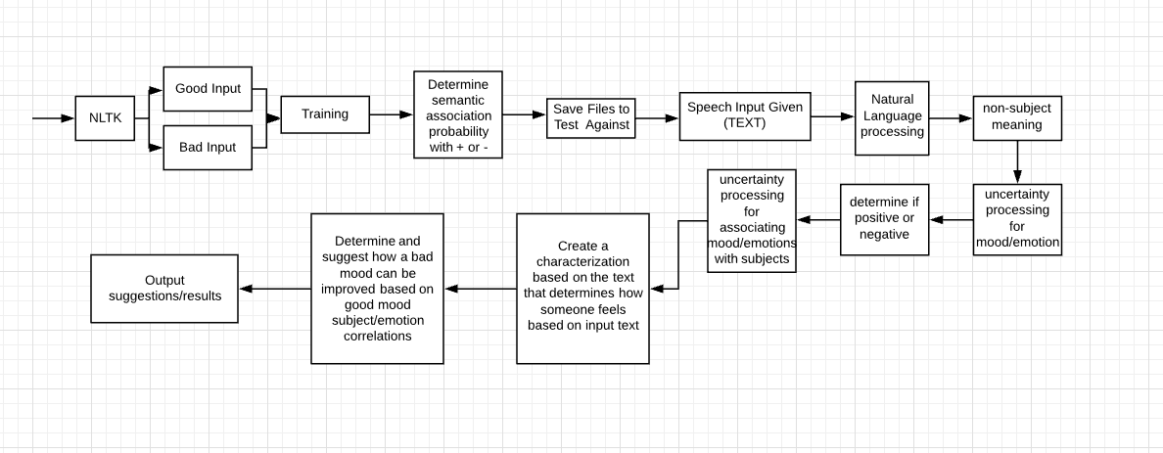
Design

Slide 5
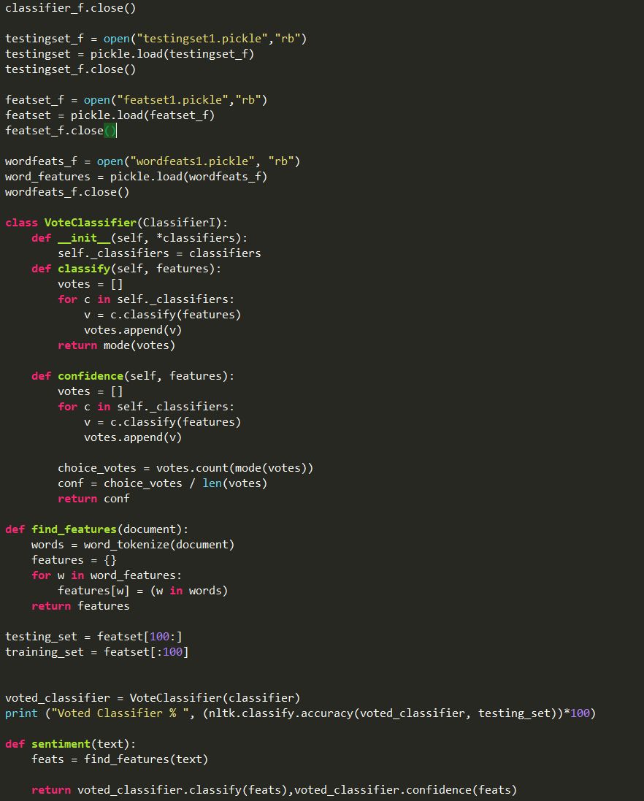
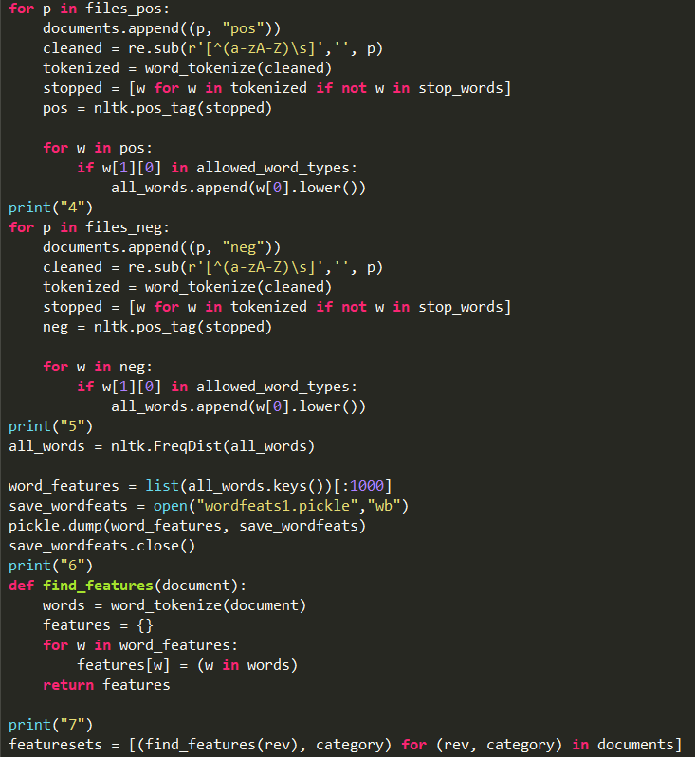
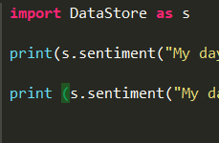
Three Steps:
Step 2: Save Train Data
Step 1: Train the AI
Step 3: Run Analyzer

Slide 6
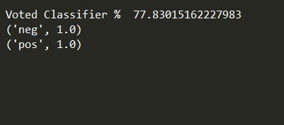
Demo
The Demo in total would take about 20 minutes~
10-15 Minutes to Train based on sample size
5-10 Minutes to load in all saved training based on sample size
5 Minutes to run based on input data size
I pre-trained the data set and had two input paragraphs. The first talking about a bad day I had, and the second thinking about a good day I had that did have some bad moments.
The results stated that the first one was negative and the second was positive with a certainty rate of 77.8%.
*This was below my 80% target goal. But the rate varied between each set, with a certainty rate between 67-81% using the Naives Bayes method.

Slide 7
What did not work
My initial idea was to have the sentiment analyzer be able to distinguish parts of the input in order to explain to you WHY the results were positive or negative, however, I was unable to implement this.
(I attribute this to the complexity of NLTK)
A nice to do requirement would have been to offer advice, but that was not implemented. Would need a specific API based on what type of data was being input.

Slide 8
Thank You!

